Slide 1



Airbus Aerothon 5.0
Team: kEDGY

Slide 2
What’s being discussed
The problem statement
The proposed approach
ER diagram and analyses
Flow Chart

Slide 3
A brief summary
In the given scenario, a washing machine manufacturing company produces a lot of washing machines with different models and types, and each type requires different logistics and technology, and is manufactured in different parts of the world. The different departments within the company generate a lot of data related to supply chain, planning, execution, and forecasting, which results in a lot of redundant intermediate data being produced. This intermediate data is without any authenticity, consumes a lot of space, and creates sustainability issues. The solution proposed is to implement a centralized data platform that acts as a single source of truth for all data related to the manufacturing process, uses real-time data feeds and batch processing to aggregate data, implements a data governance framework, and uses advanced analytics techniques to optimize the manufacturing process and improve forecasting accuracy. This solution would improve the sustainability of the approach to data usage across different departments and manufacturing units.

Slide 4
Possible solution
To reduce the amount of redundant intermediate data generated in a manufacturing supply chain, a centralized data platform could be implemented. This platform would act as a single source of truth for all relevant data and would use real-time data feeds and batch processing to collect and aggregate data from different sources. A data governance framework could be implemented to define ownership, access, and usage policies, and advanced analytics techniques could be used to optimize the manufacturing process and improve forecasting accuracy. Overall, the centralized data platform would improve the sustainability of the approach to data usage across different departments and manufacturing units.

Slide 5
Understanding the dataset
The relations between the three datasets:
The first dataset contains information about the items that are used in the production process.
The second dataset contains information about the assemblies that are created in the production process.
The third dataset contains information about the processes that are used in the production process.

Slide 6
By combining these three datasets, we can get a more complete picture of the production process. For example, we can see which items are used in which assemblies, and which processes are used to create each assembly. This information can be used to improve the efficiency and quality of the production process.
Let us now examine some specific examples of how these relations can be used:
We can use the information in the first dataset to identify items that are frequently used in multiple assemblies. This information can be used to reduce the amount of inventory that is needed.
We can use the information in the second dataset to identify assemblies that are frequently created. This information can be used to optimize the production process by scheduling the creation of these assemblies at times when the machines are available.
We can use the information in the third dataset to identify processes that are taking longer than expected. This information can be used to identify bottlenecks in the production process and to take steps to improve efficiency.

Slide 7
The need for standardization
In and of itself, the data is all over the place, arranged in a chaotic manner.
Standardization of data is a process of transforming data into a common format or scale, which allows for easier comparison and analysis. It involves converting data into a consistent format, which could be based on units of measurement, currency, or any other relevant standards. The goal of standardization is to ensure that the data is uniform, consistent, and comparable, regardless of the source or format in which it was originally collected. It is commonly used in data analysis and machine learning to prepare data for modeling and to compare different variables across datasets.

Slide 8
The fix: normalization
Normalization of data is an important process in data management and analysis because it ensures that data is organized and stored in a consistent and standardized manner. There are several reasons why normalization is important:
Reducing data redundancy
Improving data integrity
Facilitating data analysis
Enhancing data security

Slide 9
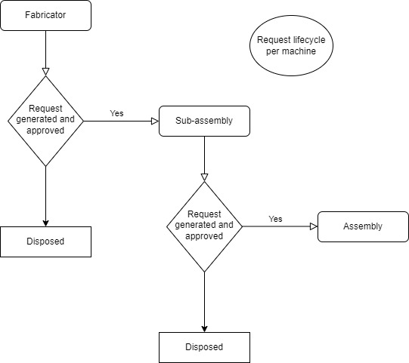
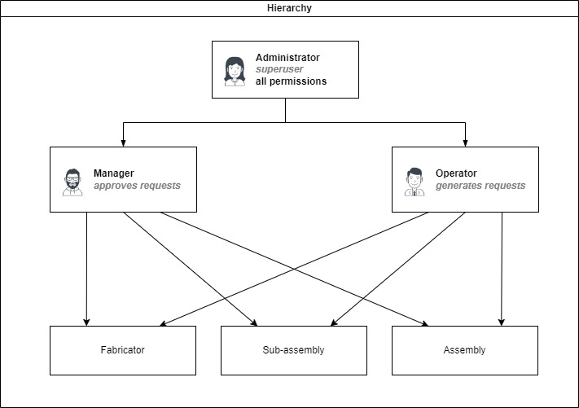
Flow Chart
Hierarchy chart

Slide 10
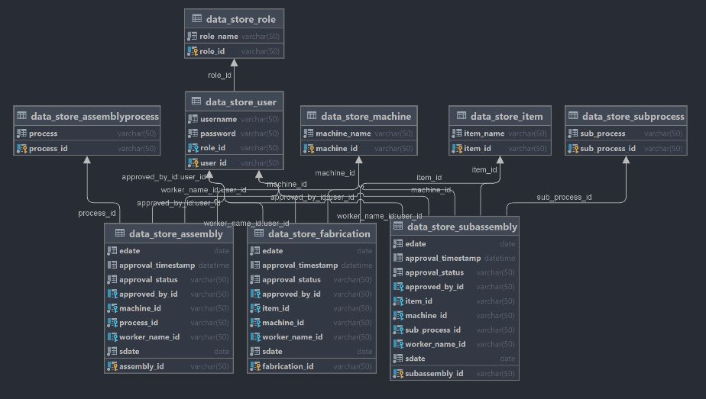
Er diagram (part-1)

Slide 11
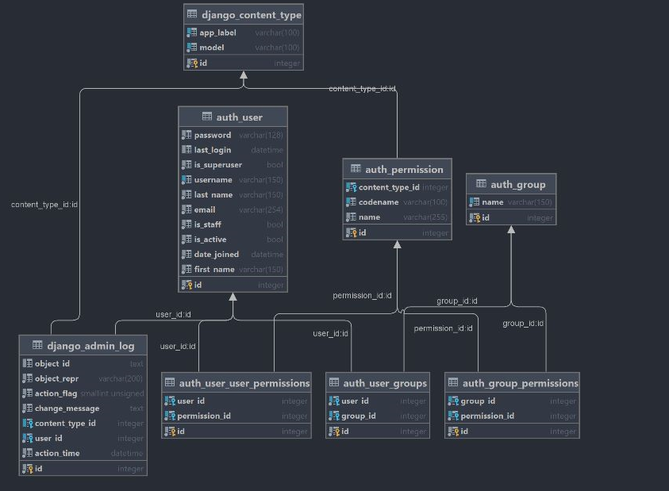
ER Diagram (part-2)

Slide 12
Increase scalability
Introduce Caching
Replication of DB Server
User DB Indexing and DB Cluster Optimally
Use of Advance Data warehouse tool

Slide 13
Thank You
Team Member
Aakarshak
Abhijay Tyagi
Kshitij
Siddharth
Sumukh

